Slide 1

Cymphony
By -
Group 13
Pratul Maurya (19BCY10036)
Param Chawla (19BCY10117)
Akshat Verma (19BCY10075)
Project Guide -
Dr. Praveen Lalwani

Slide 2
Introduction
Steganography is the technique of hiding secret data within an ordinary, non-secret, file or message in order to avoid detection; the secret data is then extracted at its destination. The use of steganography can be combined with encryption as an extra step for hiding or protecting data.
The word steganography is derived from the Greek words steganos (meaning hidden or covered) and the Greek root graph (meaning to write).
Steganography can be used to conceal almost any type of digital content, including text, image, video or audio content; the data to be hidden can be hidden inside almost any other type of digital content.
The content to be concealed through steganography -- called hidden text -- is often encrypted before being incorporated into the innocuous-seeming cover text file or data stream. If not encrypted, the hidden text is commonly processed in some way in order to increase the difficulty of detecting the secret content

Slide 3
Existing Work
Successful implementation of the algorithm for audio steganography.
A working program to select the carrier audio file and the secret file.
The user is able to choose the number of Least Significant Bits used and the number of bytes hidden which must be known to the receiver to recover data from the steganographic output at the receiving end.

Slide 4
Limitations
The secret file size is limited to few kbs and that too is dependent on the carrier file size.
Also till now the secret file must be a text file.

Slide 5
Proposed Work
Our project intended to overcome the existing problems and limitations of current steganography programs.
Our project is based on Least Significant Bit algorithm
This will allow us to create a output audio file in such a way that it retains the basic acoustic characteristics of the original carrier file.

Slide 6
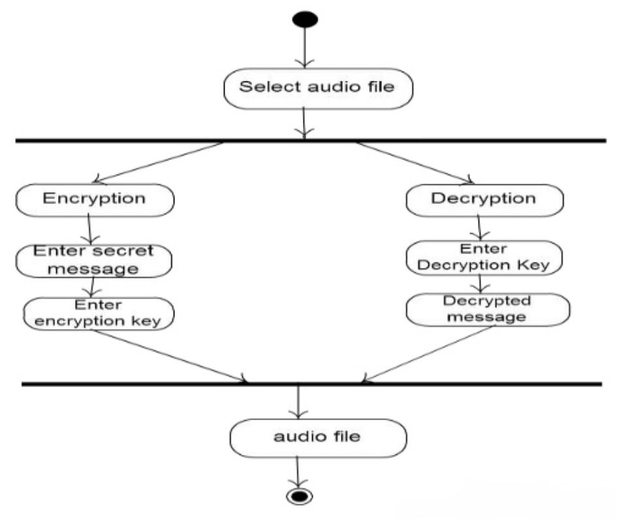
Methodology

Slide 7

Novelty of work
Trying to improve the quality of the steganographic carrier output file to keep the existence of the secret file unknown to the eavesdropper.
Improve the size of the secret file that can be stored in the public carrier file.

Slide 8
Real Time Usage
Confidential communication and secret data storing
One simple application of this for private journal keeping.
Another example is to send stego files over emails to the intended user
Protection of data alteration
We take advantage of the fragility of the embedded data in this application area.

Slide 9
Hardware & software requirements
There is no particular minimum memory requirement for Python. While it’s high level, it’s not compiled, it’s interpreted real time. Python was released in ’91 and anywhere between 1MB and 4MB was pretty much the normal.
Really all you need are:
A computer
A web browser (to download python on and to google future questions)
Python (min 3.0) and relevant modules/libraries
A text editor

Slide 10
LEAST SIGNIFICANT BIT ALGORITHM
Least Significant Bit (LSB) coding is the simplest way to embed information in a digital file audio file
By substituting the significant bit of each sampling point with a binary message
In implementation of LSB coding, the least significant bit of a sample are replaced with messaging bits
To extract a secret message from an LSB encoded sound file, the receiver needs access to the sequence of sample indices used in the embedding process

Slide 11
Overall system architecture diagram
STEP 1
STEP 3
RECEIVE THE AUDIO FILE AND THEN CONVERT IT INTO BIT PATTERN
CHECK WHICH LSB TO REPLACE AND HOW MANY LBSs TO USE.
STEP 2
STEP 4
EACH CHARACTER IN THE MESSAGE FILE IS CONVERTED INTO BIT PATTERN
REPLACES THE LSB BIT FROM AUDIO WITH LSB BIT FROM CHARACTER IN THE MESSAGE

Slide 12
ROLES AND RESPONSIBILITIES
USER MUST HAVE TO SELECT AUDIO FILE OF TYPE .WAV FORMAT
USER HAVE TO WRITE TEXT MESSAGE OR SECRET MESSAGE FOR EMBEDDING IT IN AUDIO FILE
USER MUST HAVE TO SELECT A AUDIO FILE FOR ENCODING / A STEGO-AUDIO FILE FOR DECODING MESSAGE
USER MUST KNOW THE NUMBER OF LSBs USED AND THE BYTES OF DATA HIDDEN TO SUCCESSFULLY RECOVER A FILE.

Slide 13
Why are we using a .wav file?
It has the least amount of quality decrement while recording
It’s the easiest format to develop from scratch
It gives us a file with 0% compression

Slide 14
Literature review
LSB coding allows for a large amount of data to be encoded. Among many different data hiding techniques proposed to embed secret message within audio file, the LSB data hiding technique is one of the simplest methods for inserting data into digital signals in noise free environments, which merely embeds secret message-bits in a subset of the LSB planes of the audio stream.
This proposed system is to provide a good, efficient method for hiding the data from hackers and sent to the destination in a safe manner. This proposed system will not change the size of the file even after encoding.

Slide 15
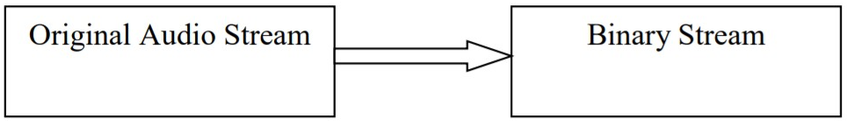
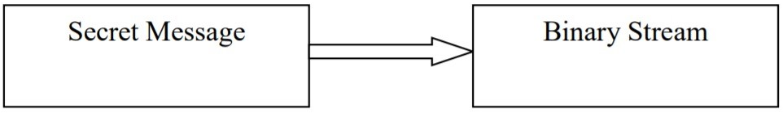
Module Workflow
1st Step: Converting original audio stream into binary stream.
2nd Step: Converting secret message into binary stream.

Slide 16
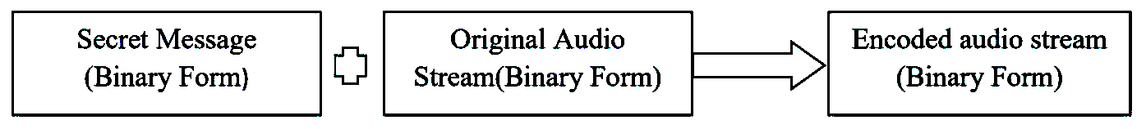
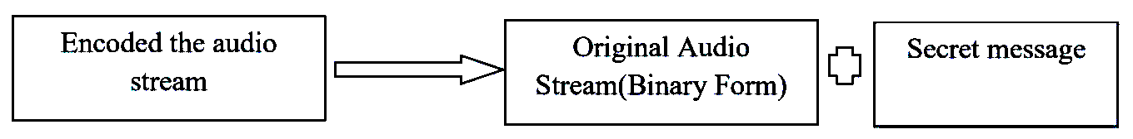
3rd Step: Embedding secret message into audio stream.
4th Step: Decoding secret message from audio stream

Slide 17
Implementation and Coding
The major goal of Steganography is to transmit data over a confidential media. Based on the type and the amount of data that needs to be transmitted carrier audio is selected.
Audio steganography is a good technique for storing small volumes of data. In any steganographic technique there are two different phases. One is at the sender phase and the other is the receiver phase.
In the sender side, an embedding algorithm is designed to embed the data into the audio file and at the receiver side retrieval algorithm is designed to retrieve the information.
These two (Embedding and Retrieval) algorithms are implemented in a single program.

Slide 18
import getopt, os, sys, math, struct, wave def print_usage() def prepare(sound_path) def hide_data(sound_path, file_path, output_path, num_lsb): def recover_data(sound_path, output_path, num_lsb, bytes_to_recover): try: opts, args = getopt.getopt(sys.argv[1:], 'hrs:d:o:n:b:', ['hide', 'recover', 'sound=', 'data=', 'output=', 'nlsb=', 'bytes=', 'help']) except getopt.GetoptError: print_usage() sys.exit(1) hiding_data = False recovering_data = False | sound_path = arg elif opt in ("-d", "--data"): file_path = arg bytes_to_recover = int(arg) elif opt in ("--help"): print_usage() sys.exit(1) elif opt in ("-d", "--data"): file_path = arg else: print("Invalid argument {}".format(opt)) try: if (hiding_data): hide_data(sound_path, file_path, output_path, num_lsb) if (recovering_data): recover_data(sound_path, output_path, num_lsb, bytes_to_recover) except Exception as e: print("Ran into an error during execution. Check input and try again.\n") print(e) print_usage() sys.exit(1)

Slide 19
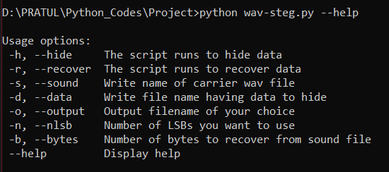
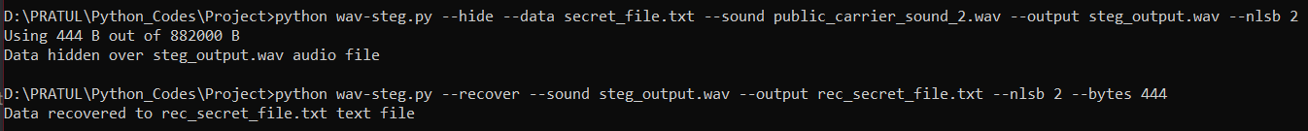
Snapshot of our Project

Slide 20
Testing
Listening tests showed that described algorithm succeeds in taking two bit positions to embed secret data without affecting the perceptual transparency of the carrier audio signal.
The tests were performed with a large collection of audio samples and individuals with different background and musical experience.
None of the tested audio sequences had perceptual artifacts when used for data hiding.

Slide 21
Result and Discussion.
(Input and output)
The user has to provide the program with two files i.e. the secret text message and the public carrier sound that will be used to hide the message.
The user then choose the number of Least Significant Bits to use and then the program embeds the the secret data with the public carrier sound to give a output sound file.

Slide 22
On the receiver’s end the user has to provide the embedded sound file as input along with the number of Least Significant Bits to used and the bytes of data hidden.
Then the program gives the secret message from the embedded audio as a text file output.
However it must be noted that entering even one of them wrong (LSBs used or bytes of data hidden) will result in getting a corrupted text output or an incomplete one.

Slide 23
Conclusion
We present an intelligent framework for steganography using LSB encoding for audio data. The idea of the algorithm is that two watermark bits are embedding which provides the minimal distortion of the fixed length host audio with high capacity.
The improvement in robustness in presence of additive noise is obvious, as the proposed algorithm obtains significantly lower bit error rates than the standard algorithm .

Slide 24
Steganography has a number of drawbacks when compared to encryption. It required a lot of overhead to hide a relatively few bits of information. Once the system is discovered it becomes virtually worthless.
Experimental results show that the stego-audio is audibly indistinguishable from the original cover-audio when n<=4, because of better PSNR (Peak signal-to-noise ratio) which is achieved by this technique.

Slide 25
THANK YOU

Slide 26

References
https://alphamanual.audacityteam.org/
https://www.ijcsmc.com/docs/papers/April2014/V3I4201468.pdf
https://medium.com/
https://docs.python.org/
https://asmp-eurasipjournals.springeropen.com/articles/10.1186/1687-4722-2012-25
https://www.ijirae.com/volumes/vol1/

